Slide 1
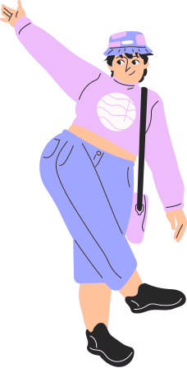


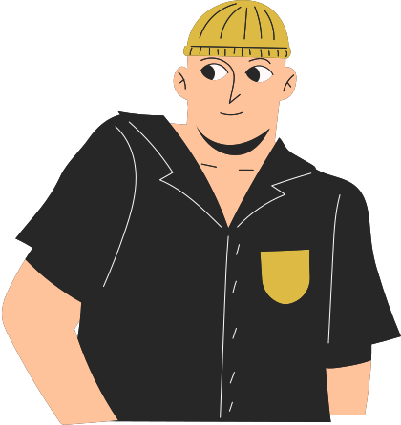
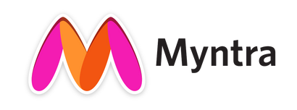
Coderellas’
Fashion Fantasy
Engagement on a shopping platform
By:-
Aisha Waseem Khan
Srijen Mishra
Vidhi Gupta

Slide 2

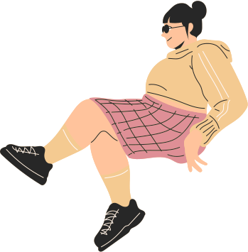

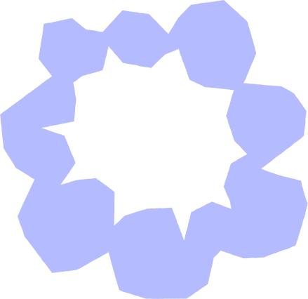



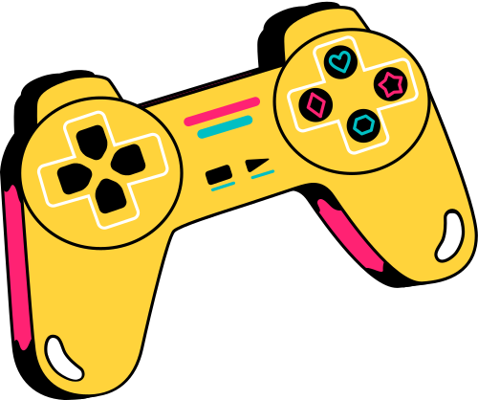
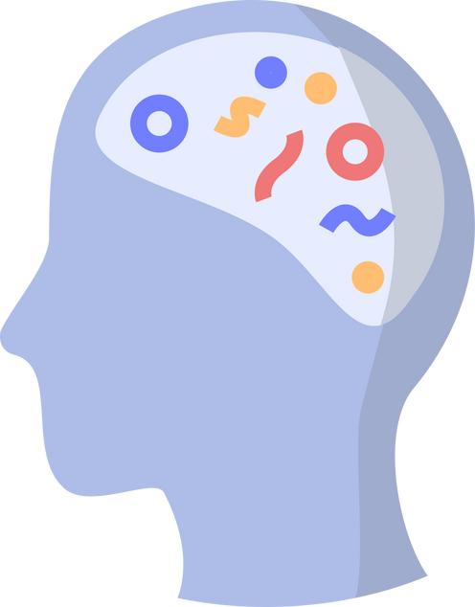
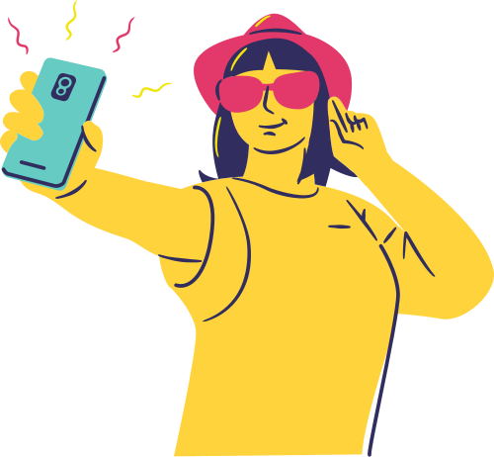





User Journey Map
Online
Meet Arya, a 20-year-old college student with a healthier body type, who is fashion-conscious and seeks a platform that promotes inclusivity and community support.
Survey
Insights
A platform to design outfits that suits her body with personalized AI recommendations.
To participate in challenges, and contests.
Opportunities to showcase her fashion creations and get feedback from the community.
Expectations
Phase 1
Phase 2
Personalized recommendations can increase conversion rates by up to 30%."
Phases
Gamification can increase user activity by 48%.
Analysis
.
She plans to explore trending fashion on Myntra.
Opens the app and searches for latest Co-ords set for her body type.
She likes the upper part of one set, and bottom part of other set and wants to combine them together.
But it can’t be helped so she leaves disappointed.
Activity
Positive
excited, hesitant
70% of Gen Z consumers in the US spend more than one hour per day on fashion-related apps.
Emotions
Negative
Unsatisfied
Good
Bad due to limited option.
Experience

Slide 3




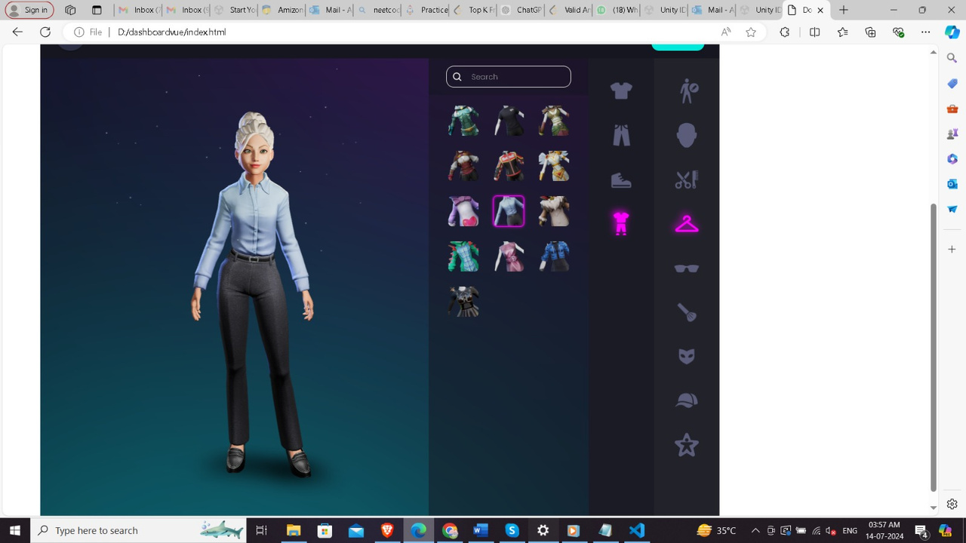

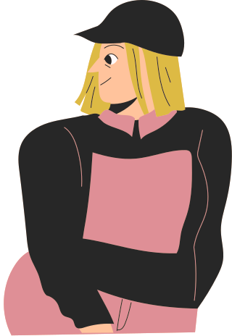
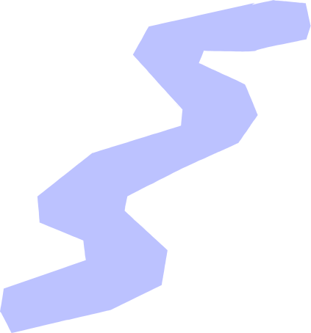
Our Solution
To address Arya's needs, we have designed an innovative solution: the "Myntra Glam Lab".
Our "Makeover Game" empowers users, especially Gen Z who grew up playing similar games, to develop virtual outfits using a wide range of available fashion items.
Image.
Users can earn points for likes on their outfits, driving engagement through community interaction.
This platform fosters a sense of belonging and inclusivity, making it a go-to destination for fashion enthusiasts like Arya.

Slide 4

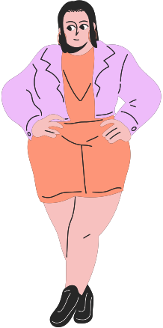
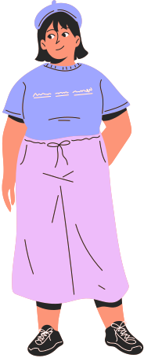


Flow of solution
STEP 3
(PART 2)
STEP 1
STEP 2
On main page of Myntra, visit Glam Lab section from the navigation bar.
Filter designers on based of location and explore their designed outfits.
Click on Design Button option to create your own design.
STEP 3
(PART 1)
STEP 3
(PART 3)
STEP 4
Click on Edit option to start the Game and redesign the designers outfit
Challenge them and earn points and reward through likes.
Look 1
After choosing the category start your Game to design your model with AI recommendations.
Look 2

Slide 5




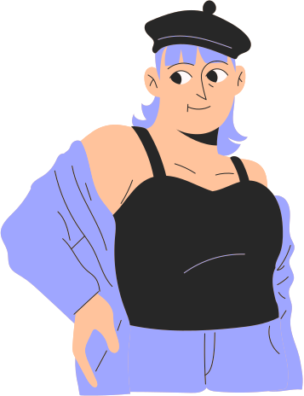

Simple Ways to
Earn Points
3
1
Weekly/Monthly Contest.
Participate in weekly challenges earn extra points.
Daily Login bonus.
Create 7 days login streak to win big.
2
4
Likes=Points
Harness the power of community engagement to gain maximum likes.
Points=Rewards
Redeem points for amazing coupons, prizes and much more.

Slide 6


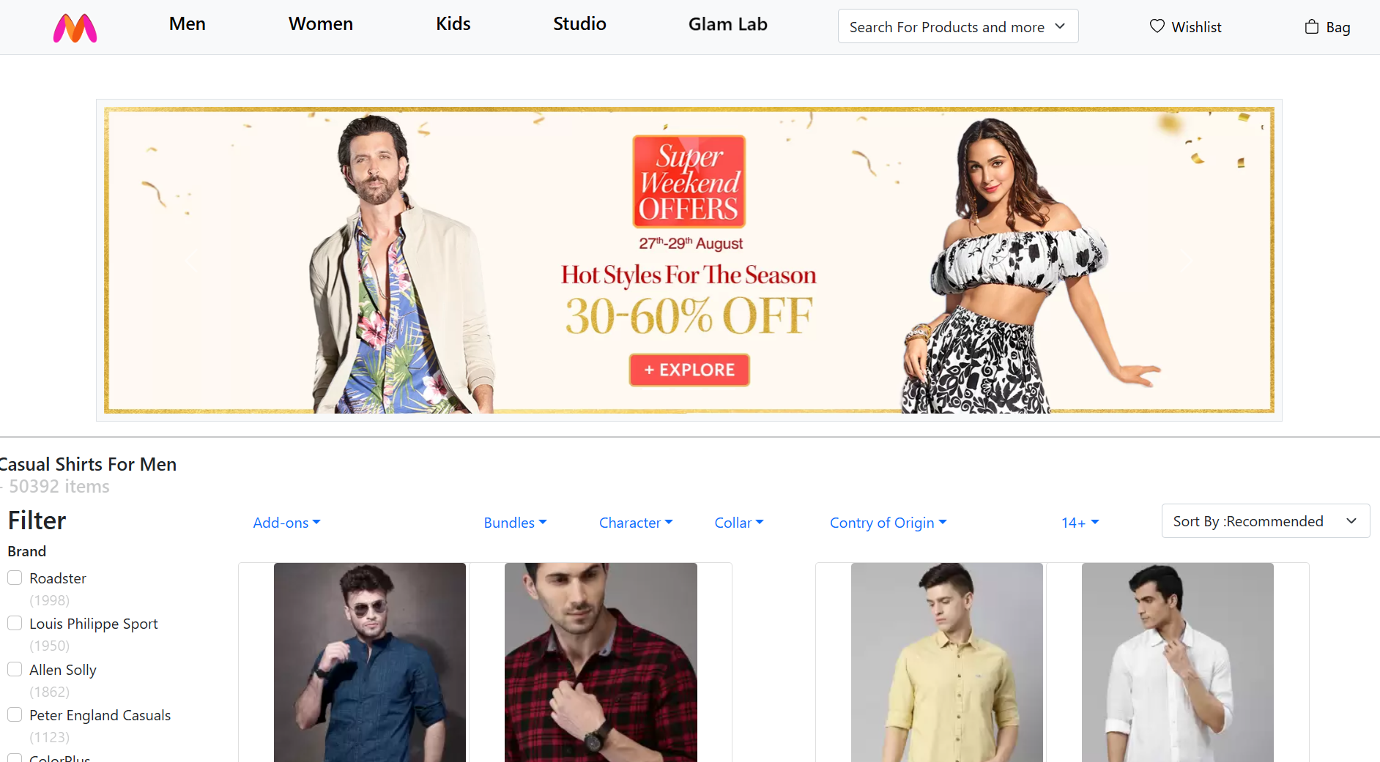


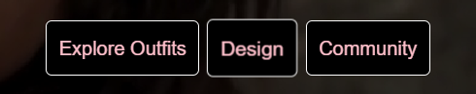

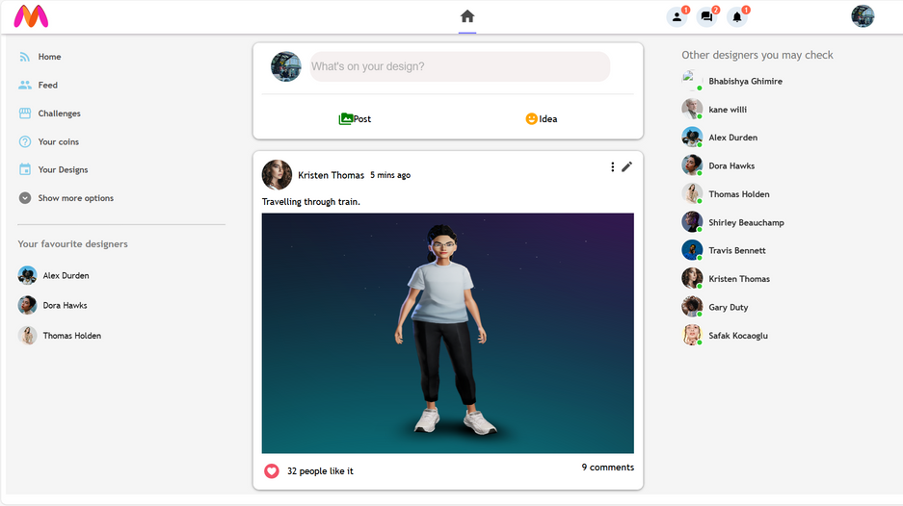
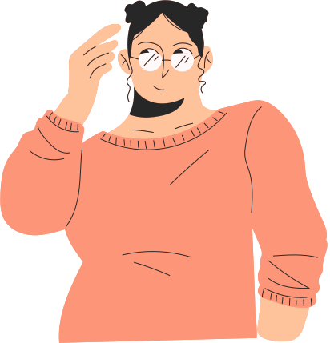

Share on Myntra Community.
Create Your Outfit.
Win Reward points for each like.

